Slide 1
trendmine
Ecommerce website With Datamining

Slide 2




Group Members
Syed Shahnoor Hasan
M.Faizan
Abdul Moiz Ansari
Maryam Ali Asghar
Group Leader,
Strategic Business Planner
Project Manager,
Developer
Group Member
Group Member

Slide 3
introduction
Introducing our Group Project,
we are an Ecommerce website which provide solutions for all your shopping needs.

Slide 4
objectives
ENHANCE USER EXPERIENCE
To provide users with such a solution for all their daily mundane shopping to buying high quality products at one place
PROVIDE BEST OFFERS
We wanted to provide user with the best offers to get the most benefits through an unlimited choice of selection
BENEFIT TO BOTH
Through our algorithms create such offers which give benefit to both
BENEFIT TO ORGANIZATION
We wanted to improve the use of our website through the best engagement of customer and provide a through customer support

Slide 5
Software used
Visual Studio Code
Sql Server Management Studio
Lucid Chart
Afsana App

Slide 6
FEATURES
Advanced Data Mining Algorithms:
Robust Database Design:
Charitable Contribution Integration:
Well-structured relational database, ensuring data accuracy, minimizing redundancy, and supporting efficient data management.
Seamless integration allows users to contribute to charitable causes during their shopping experience, promoting social responsibility.
Cutting-edge algorithms analyze user behavior to identify trends, optimize discount strategies, and enhance user satisfaction.

Slide 7
FEATURES
Efficient Admin Management:
Seasonal Trends Optimization:
Responsive Design:
Administrative tools for streamlined platform management, including inventory control, order tracking, and insightful analytics.
Strategic implementation of seasonal trends, offers, and discounts to optimize sales and attract customers throughout the year.
responsive design ensures a consistent and optimized user experience across various devices.

Slide 8
Innovations
Dynamic Product sections for each user
Auto Optimization Product Offers
Generation Of Product Offers Through Data Minning

Slide 9
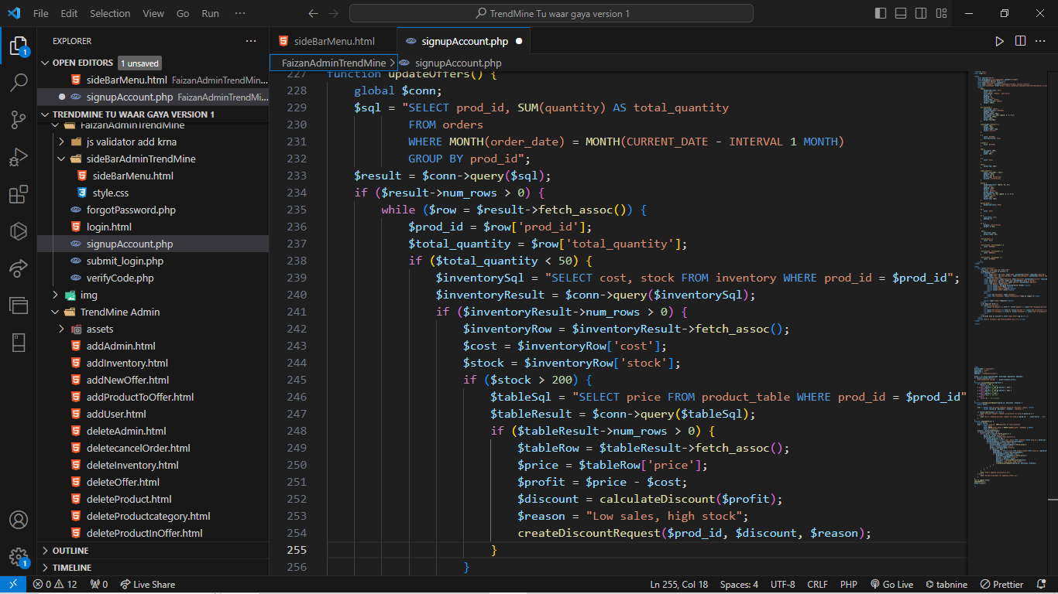
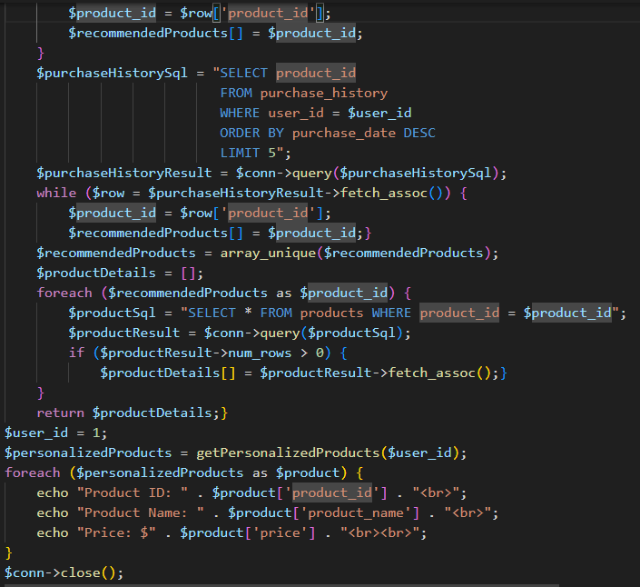
Innovative technology

Slide 10
Data mining
Data mining is the process of uncovering hidden patterns and valuable insights from large datasets. It involves the use of statistical techniques, machine learning algorithms, and data analysis to extract meaningful information. The goal is to transform raw data into actionable knowledge for decision-making. Applications include identifying trends, patterns, and correlations in various industries.

Slide 11
THANK YOU

